Slide 1
Microcontroller Based System Design
CSE 3216
LAB 1

Slide 2
Course Teachers:
Ashna Nawar Ahmed
Lecturer
Department of CSE
AUST
Email: ashna.cse@aust.edu
Phone: 01710812206
Farzad Ahmed
Lecturer
Department of CSE
AUST
Email: farzad.cse@aust.edu
Phone: 01685245342

Slide 3
Google Classroom Code
v3t5p5x

Slide 4
Hardware Project Criteria
Must be beneficial to society
Should be budget friendly
Must be a team project
Each team member must contribute to the project

Slide 5
Lab 1
Introduction to MSD Lab
Lecture
Lab 2
Lecture
Lab 3
Lecture
Lab 4
Lab 5
Lab 6
Lab 7
Group formation
Project Proposal Submission
Lecture
Lecture
Project Submission
Presentation + Report + Final Project + Viva
Presentation + Report

Slide 6
What is Arduino?
Arduino is an open-source electronics platform based on easy-to-use hardware and software.
Arduino boards are able to read inputs - light on a sensor, and turn it into an output - activating a motor.
You can tell your board what to do by sending a set of instructions to the microcontroller on the board. To do so you use the Arduino programming language and the Arduino Software (IDE).

Slide 7
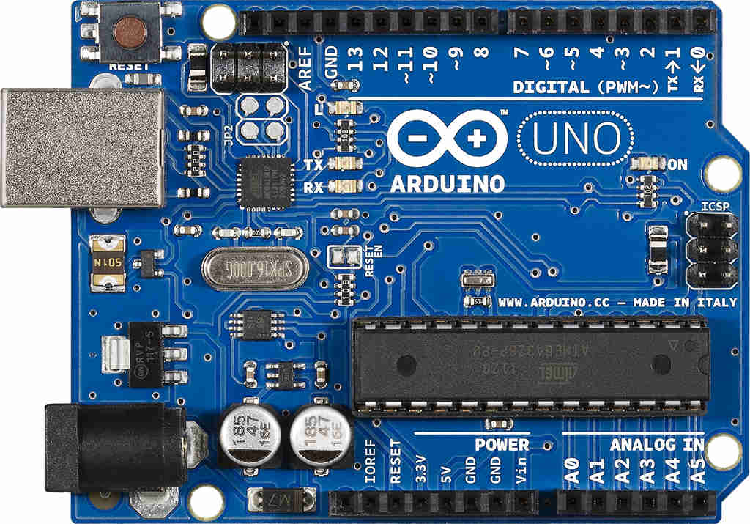
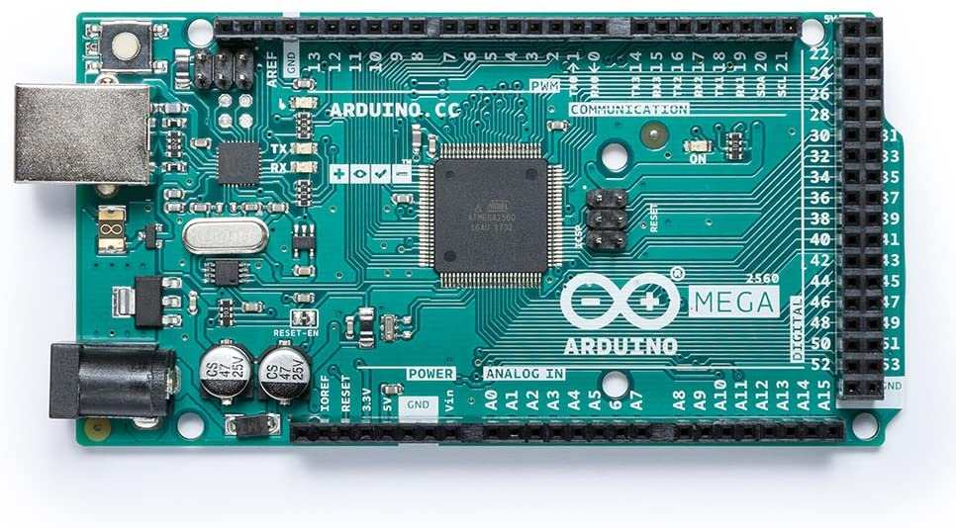
Different Types of Arduino Boards
Arduino UNO-> 14 digital pins, 6 analog pins
Arduino MEGA-> 54 digital pins, 16 analog pins

Slide 8
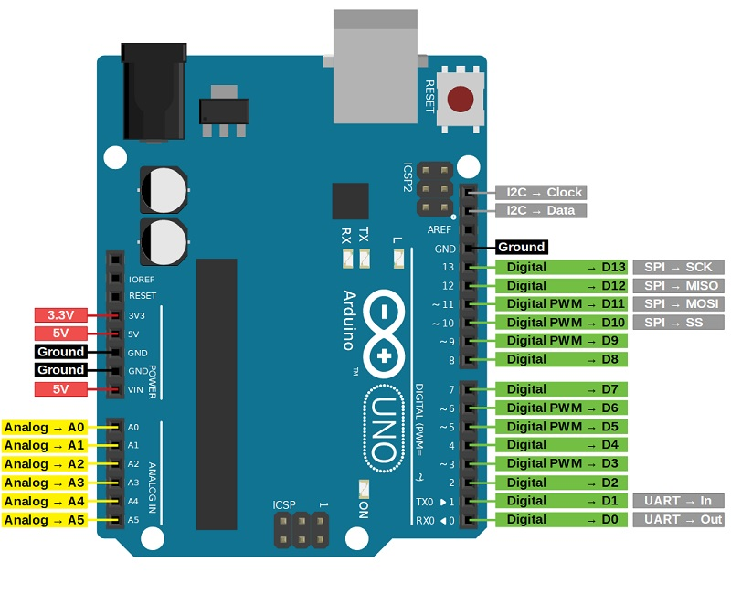
Arduino UNO Pin Diagram

Slide 9
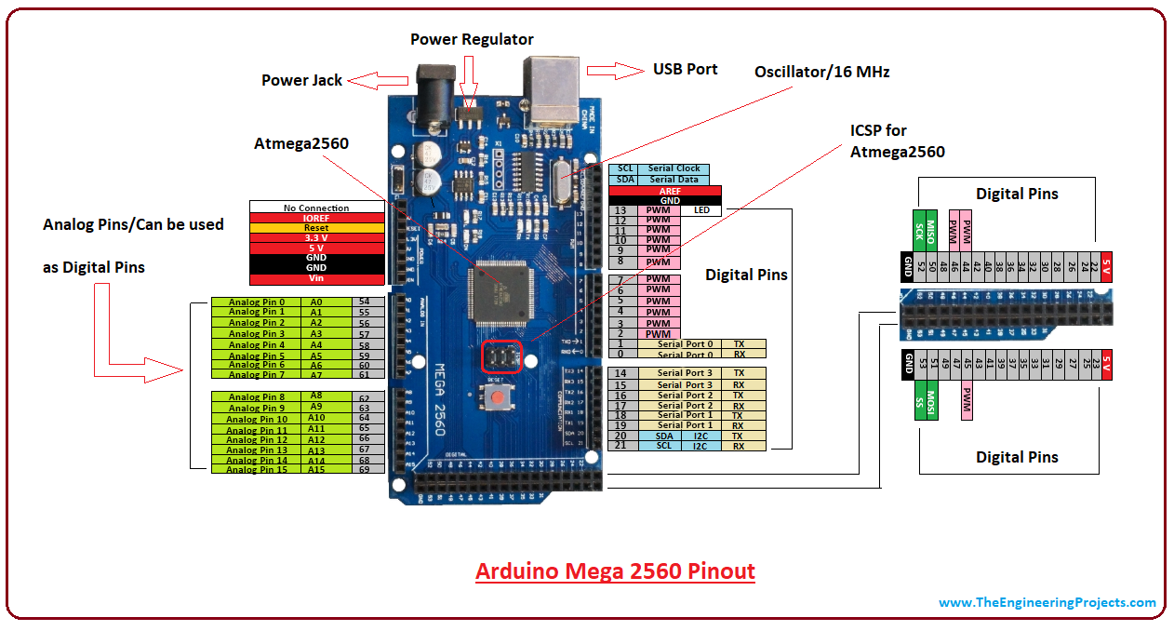
Arduino MEGA Pin Diagram

Slide 10
Arduino programming language
Arduino programming language can be divided in three main parts:
structure,
values (variables and constants), and
functions.

Slide 11
Structure of Arduino Code

Slide 12
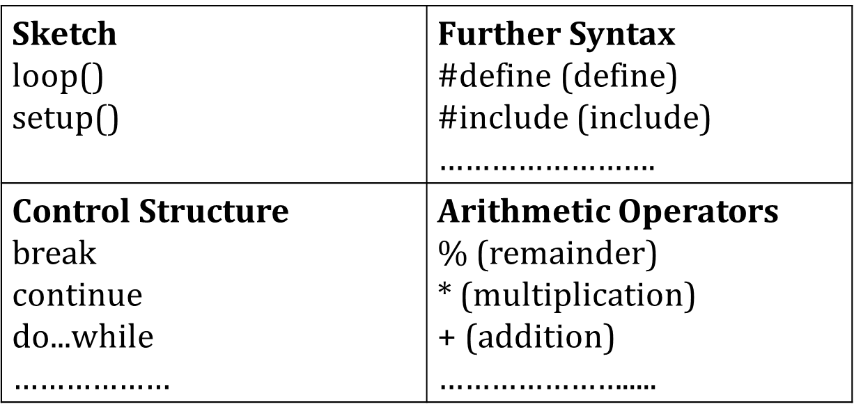
The elements/structure of Arduino (C++) code:

Slide 13
Functions of Arduino Code

Slide 14
FUNCTIONS of arduino
For controlling the Arduino board and performing computations.
Digital I/O
digitalRead() digitalWrite() pinMode()

Slide 15
digitalRead()
Description
Reads the value from a specified digital pin, either HIGH or LOW.
Syntax
digitalRead(pin)
Parameters
pin: the number of the digital pin you want to read
Returns
HIGH or LOW

Slide 16
digitalWrite()
Description
Write a HIGH or a LOW value to a digital pin.
Syntax
digitalWrite(pin, value)
Parameters
pin: the pin number
value: HIGH or LOW
Returns
Nothing

Slide 17
pinMode()
Description
Configures the specified pin to behave either as an input or an output.
Syntax
pinMode(pin, mode)
Parameters
pin: the number of the pin whose mode you wish to set
mode: INPUT, OUTPUT

Slide 18
Basic Arduino Code
The bare minimum of code needed to start an Arduino sketch.
void setup() {
// put your setup code here, to run once:
}
void loop() {
// put your main code here, to run repeatedly:
}

Slide 19
Blinking LED
int ledpin = 12;
void setup() {
pinMode(ledpin,OUTPUT);
}
void loop() {
digitalWrite(ledpin,HIGH);
delay(500);
digitalWrite(ledpin,LOW);
delay(500);
}

Slide 20
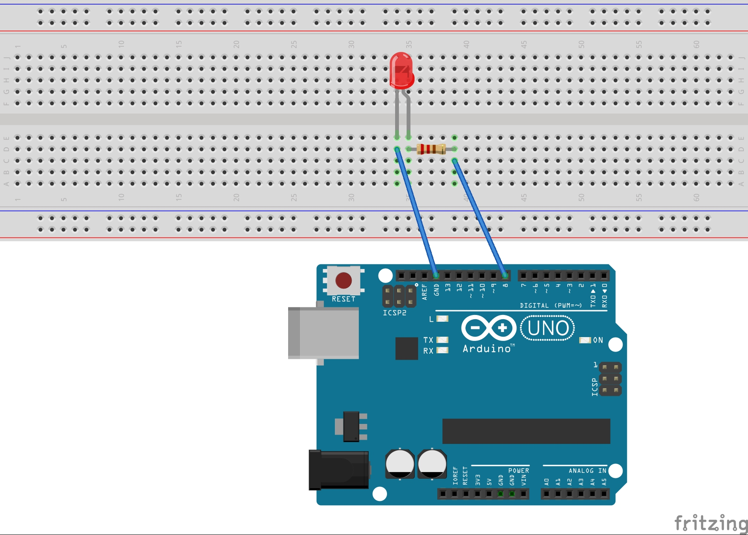
How to connect LED to Arduino UNO

Slide 21
Task for Students
Connect 3 LEDs to Arduino, and make them blink in different patterns on a loop.
LED1 -> LED2 -> LED3 -> LED2 -> LED1
LED1 -> LED2 -> LED2 -> LED3 -> LED3 -> LED3

Slide 22
THE END

